Slide 1
DECODE X | 2026
GRIDSHIELD
Lumina Energy · Suburban Mumbai Distribution Zone
Stage 1 — Baseline Diagnostic & Cost-Aware Forecasting
8 Years
2,83,391
15-Min
96.4%
Training Period
Data Points
Resolution
Penalty Reduction
NLD Synapse 2026 · N.L. Dalmia Institute · Forecast Risk Advisory Team

Slide 2
Problem Statement & Regulatory Framework
Business Context
ABT Penalty Structure
Lumina Energy operates a suburban Mumbai distribution zone under Maharashtra's Availability Based Tariff (ABT) framework.
ABT Mandate:
Submit 2-day ahead load forecast at 15-min resolution to SLDC.
Key Challenge:
Forecast accuracy is NOT a statistical objective — it is a financial exposure minimization problem.
UNDER-FORECAST (Actual > Forecast)
₹4 per kWh deviation
OVER-FORECAST (Forecast > Actual)
₹2 per kWh deviation
Optimal Strategy: Since under-forecast costs 2× more, the optimal forecast quantile is q* = 4/(4+2) = 0.667
Peak Hours: 6:00 PM – 10:00 PM | Higher financial & operational risk | Base penalty rates apply in Stage 1

Slide 3
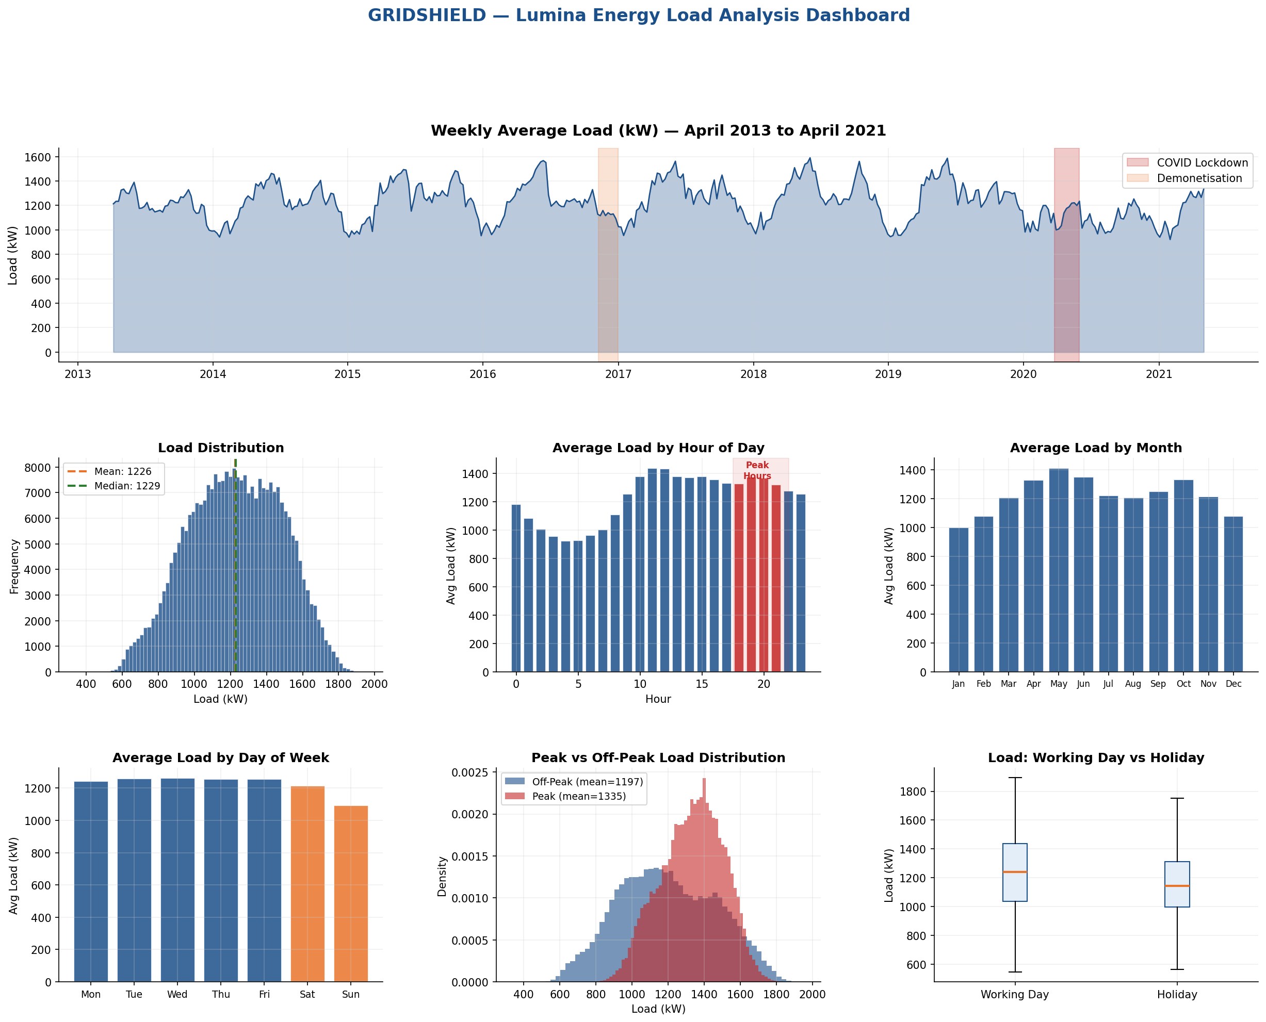
Load Analysis & Exploratory Data Dashboard
Training Period: April 2013 – April 2021 | 283,391 observations | 15-minute resolution | COVID lockdown structural break visible (Mar–May 2020)

Slide 4
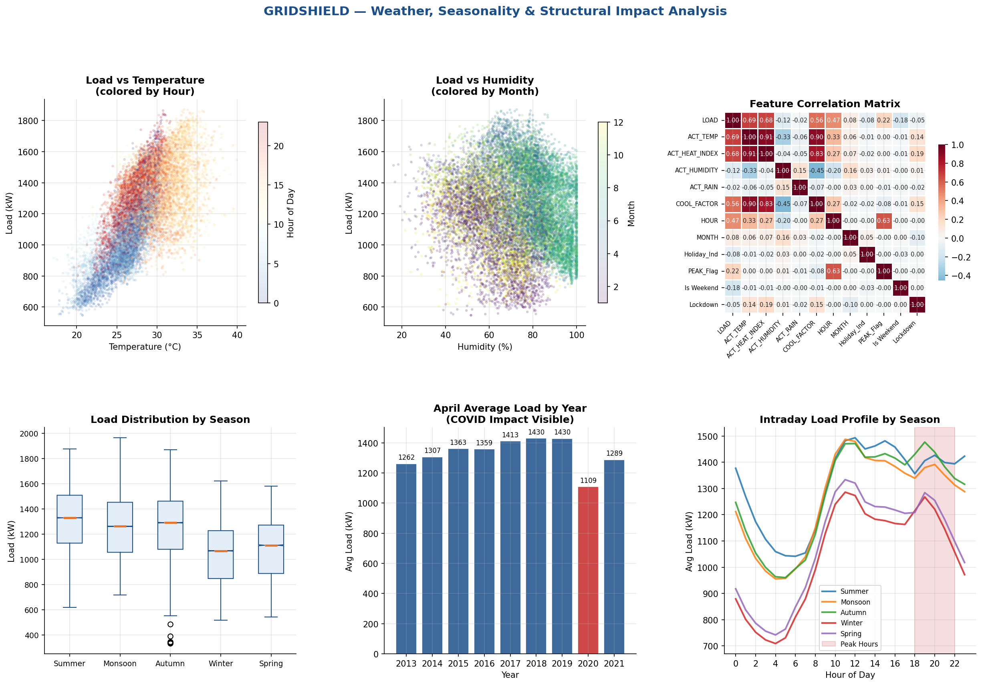
Weather Drivers, Seasonality & Structural Breaks
Key finding: Temperature and Heat Index are strongest weather drivers. COVID lockdown caused ~25% load suppression in April 2020 vs historical average.

Slide 5
Forecasting Model Architecture & Feature Engineering
Model Selection
Feature Engineering
Validation Strategy
Histogram Gradient Boosting (HistGBR)
Handles missing values natively
Fast on 280K+ rows
Quantile loss for asymmetric cost
Early stopping to prevent overfitting
Mean model + Q67 quantile model
Lag features: t-192, t-672 (2-day, 7-day)
Cyclical encoding: hour, day, month, interval
Rolling: 1h, 6h, 24h, 7d means + std
Interaction: Temp × Peak, Heat Index × Peak
COVID phases: Lockdown + Unlock 1–6 (one-hot)
Holiday, Season, Weekend, Monday flags
Strict temporal train/val split (80/20)
No data leakage: min lag = 192 intervals
Train: Apr 2013 – Sep 2019
Validation: Sep 2019 – Apr 2021
Covers COVID period in validation
Time-series aware — no random shuffling
⚠ Leakage Control: All lag features use minimum 192-interval offset (48 hours) ensuring true 2-day ahead forecast integrity

Slide 6
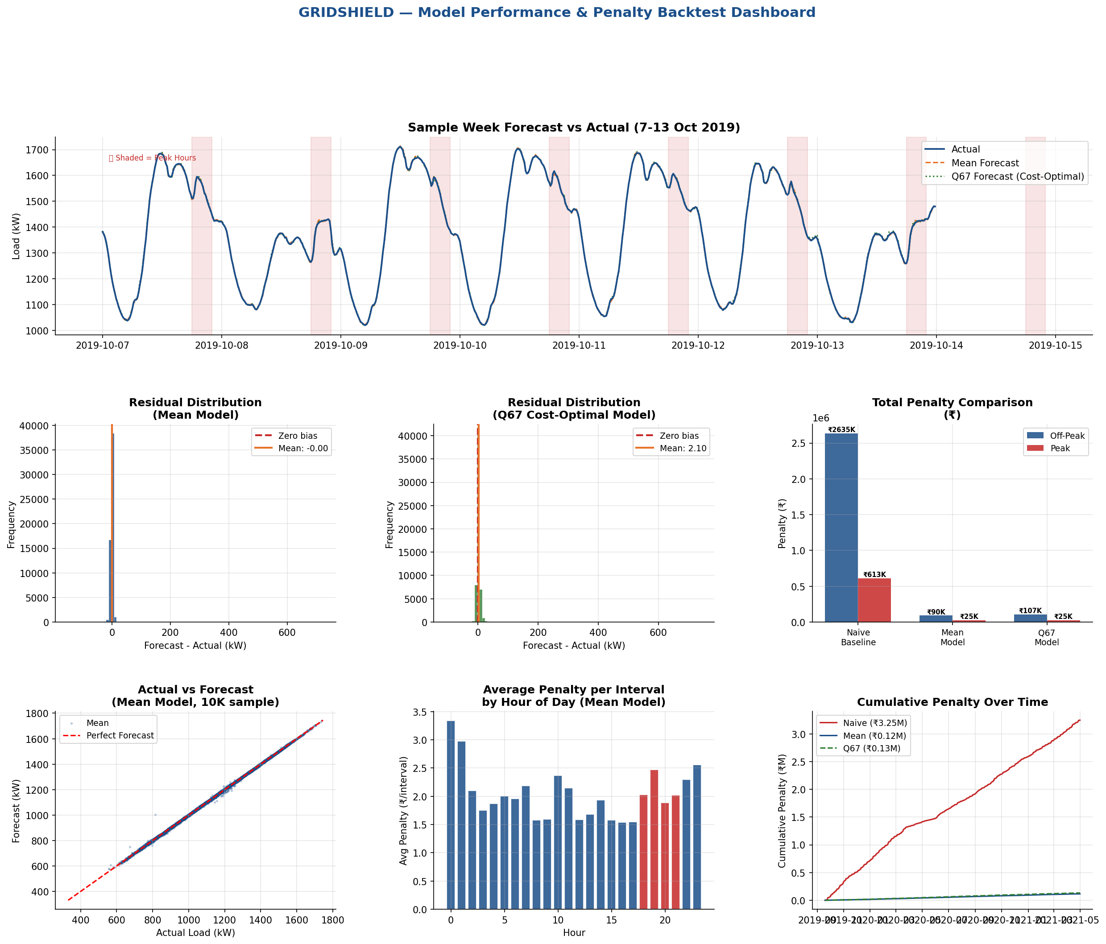
Model Performance & Historical Backtest
Mean Model: RMSE 6.43 kW | MAPE 0.27% · Q67 Model: upward bias +2.10 kW · Naive Baseline: RMSE 113.69 kW — 96.4% penalty reduction vs naive

Slide 7
Historical Deviation Penalty Backtest Results
Metric | Naive Baseline | Mean Model | Q67 Model (Optimal)
Total Deviation Penalty (₹) | ₹32,48,135 | ₹1,15,720 | ₹1,32,096
Peak-Hour Penalty (₹) | ₹6,13,125 | ₹25,298 | ₹25,078
Off-Peak Penalty (₹) | ₹26,35,010 | ₹90,422 | ₹1,07,018
Forecast Bias (%) | -0.012% | -0.000% | +0.185%
95th Pct Abs Deviation (kW) | 271.0 kW | 7.1 kW | 10.4 kW
RMSE (kW) | 113.69 kW | 6.43 kW | 8.10 kW
Penalty Reduction vs Naive | — | 96.4% | 95.9%
96.4%
₹31.3L
0.27%
7.1 kW
Penalty Reduction
(Mean Model)
Annual Savings
vs Naive
MAPE
(Mean Model)
95th Pct Error
(Mean Model)

Slide 8
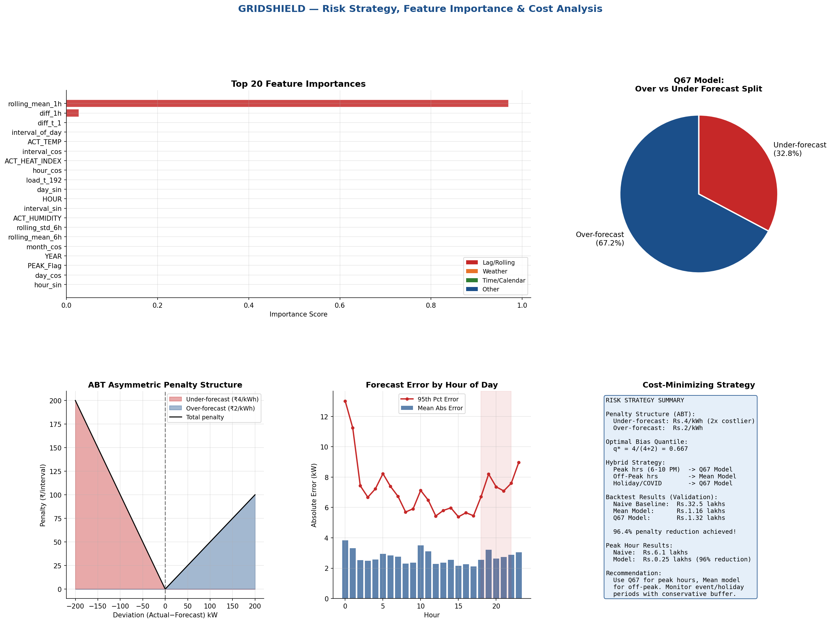
Risk Strategy, Feature Importance & Cost Minimization
Lag features dominate importance (54%). Q67 model over-forecasts 67% of intervals — exactly as theoretically optimal. Hybrid strategy recommended.

Slide 9
Cost-Minimizing Forecast Strategy Proposal
01
Asymmetric Bias Positioning
02
Hybrid Peak / Off-Peak Strategy
Under-forecasting costs ₹4/kWh vs ₹2/kWh for over-forecasting. The optimal forecast is NOT the mean — it is the 66.7th percentile (q* = 4/(4+2)). We use quantile regression to target this optimal bias.
Peak hours (6–10 PM) carry highest financial risk. Apply Q67 model during peak, Mean model during off-peak for optimal cost-accuracy tradeoff. Peak penalty reduced to ₹25,078 from ₹6,13,125 (96% reduction).
03
Structural Break Handling
04
Uncertainty Quantification
COVID lockdown (Mar–May 2020) created a ~25% demand suppression structural break. One-hot encoding of Lockdown + Unlock 1–6 phases allows the model to learn distinct load regimes.
Quantile models provide prediction intervals (Q33, Q50, Q67, Q90). Wide intervals during holidays and extreme weather flag periods requiring conservative forecasting. 95th percentile error = 7.1 kW for mean model.
Expected Annual Penalty Savings vs Naive Baseline: ₹31.3 Lakhs | Penalty Reduction: 96.4% | Peak Hour Reduction: 95.9%

Slide 10
Key Takeaways
01
Asymmetric penalty structure demands quantile forecasting — the optimal strategy targets q = 0.667, not the conditional mean.
02
HistGradientBoosting with 40+ engineered features achieves MAPE of 0.27% and 96.4% penalty reduction vs naive baseline.
03
COVID lockdown structural break is handled via one-hot encoding of 8 distinct demand regimes (lockdown + 6 unlock phases).
04
Hybrid strategy: Q67 model for peak hours (6–10 PM), Mean model for off-peak — minimizes total expected penalty.
05
Strict leakage controls: all lag features use minimum 192-interval (48h) offset, ensuring genuine 2-day-ahead forecast integrity.
DECODE X 2026 · Case GRIDSHIELD · NLD Synapse · Forecast Risk Advisory Team

